Slide 1

Team Name :CYBER DRAGON
Team Leader Name :VELAVAN.G
Problem Statement :AI FOR LEARNING AND DEVELOPER PRODUCTIVITY

Slide 2

Brief about the Idea:
AI enhances learning by offering personalized guidance, instant feedback, and adaptive content, helping learners master skills faster. For developers, AI automates routine tasks like code generation, debugging, and documentation, improving efficiency and reducing development time. Together, AI accelerates education and software creation, enabling faster learning, higher-quality code, and increased innovation.

Slide 3
Your solution should be able to explain the following:
How different is it from any of the other existing ideas?
How will it be able to solve the problem?
USP of the proposed solution
Existing Tools | Proposed Solution | USP
Focus only on learning (tutorials, courses) OR productivity (code assistants, automation) | Combines learning + productivity in one platform | “The only AI that teaches while building, and builds while teaching.”
Static, one‑size‑fits‑all resources | Adaptive learning tailored to developer’s skill level | Personalized growth that evolves with each developer
Limited to snippets, autocomplete, or project management | Provides real‑time mentorship, automates repetitive tasks, and improves code quality | Accelerates both developer growth and output simultaneously

Slide 4
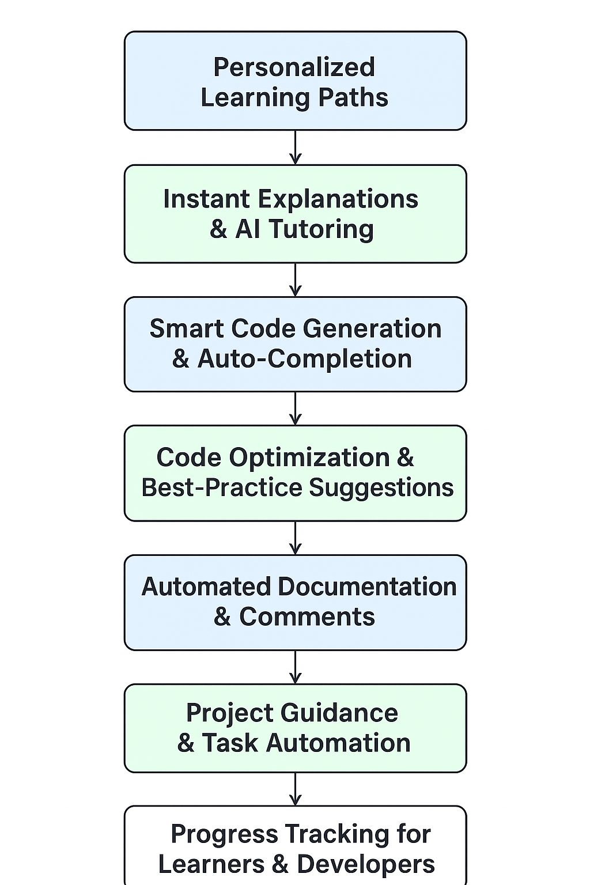
List of features offered by the solution
.

Slide 5
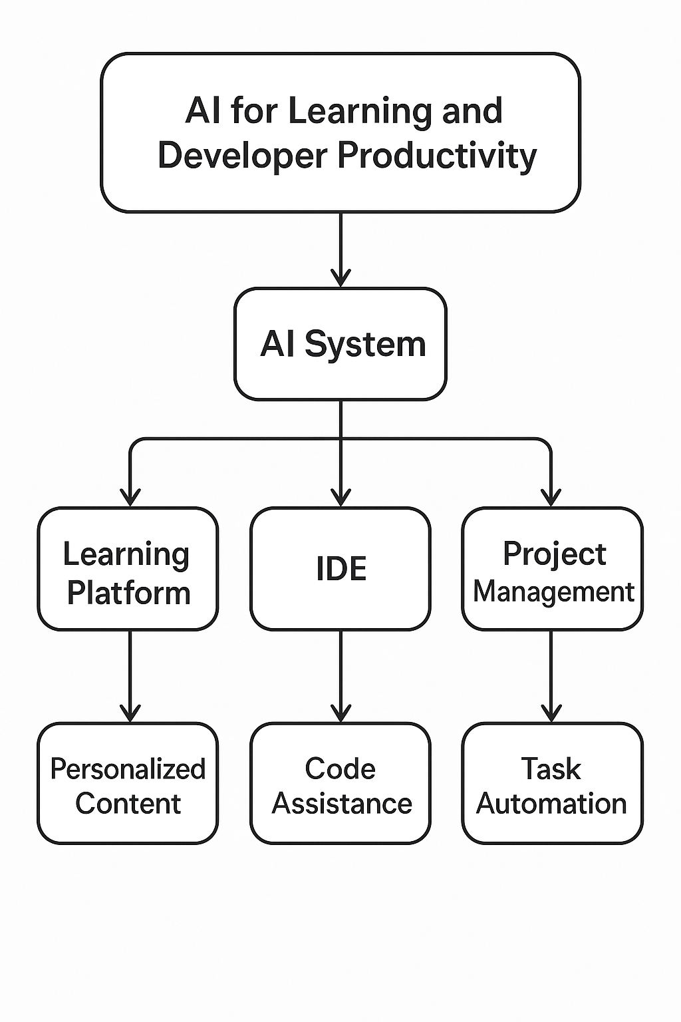
Process flow diagram or Use-case diagram
Add a flow diagram or a use case diagram or an architecture diagram.

Slide 6
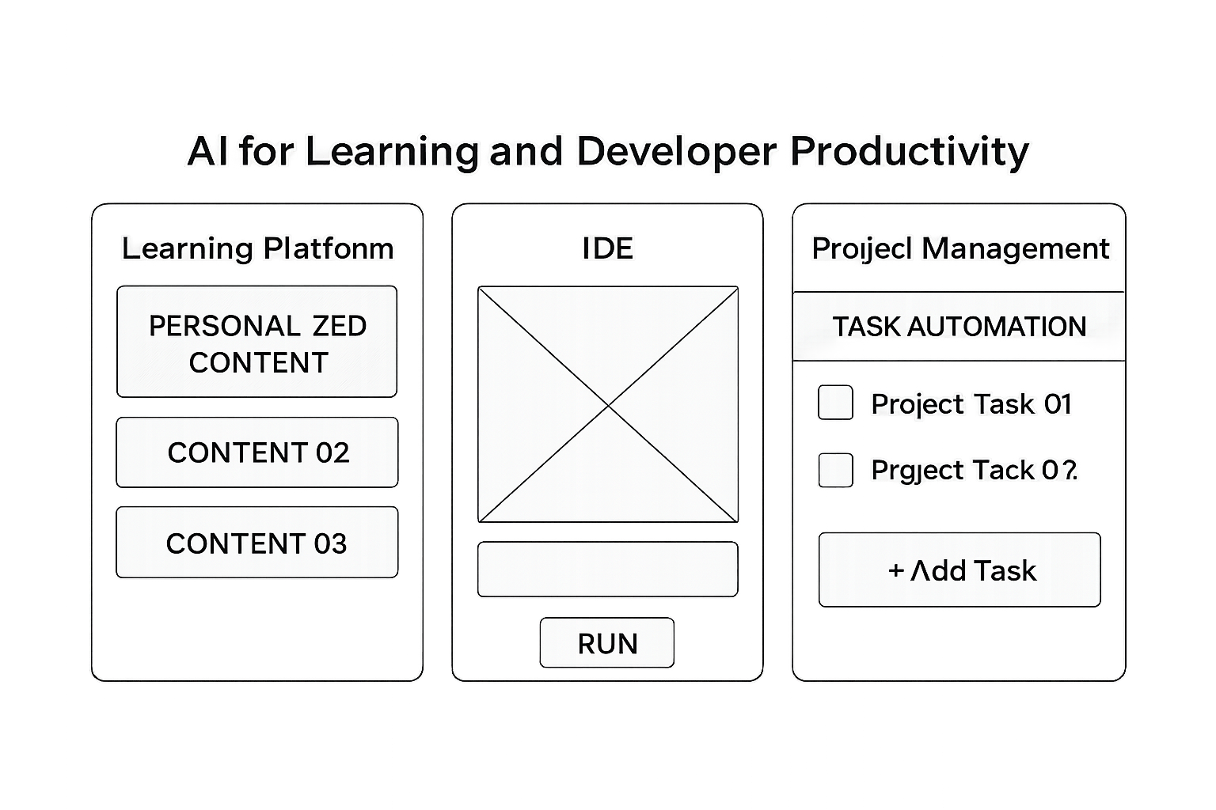
Wireframes/Mock diagrams of the proposed solution (optional)

Slide 7
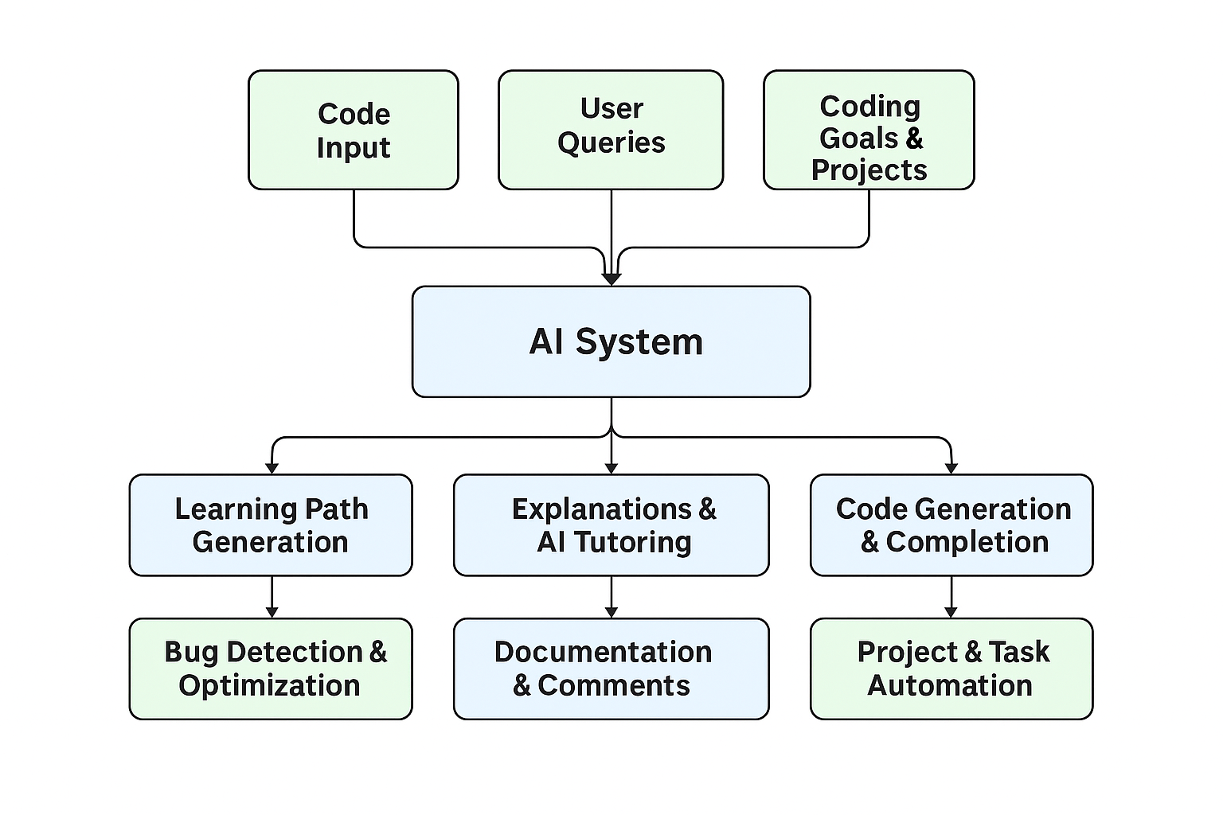
Architecture diagram of the proposed solution:

Slide 8
Technologies to be used in the solution:
Frontend: React.js + Tailwind CSS
Backend: Node.js or FastAPI
AI/ML: Hugging Face Transformers, OpenAI Codex
IDE Integration: VS Code Extensions
Task Automation: Zapier or custom cron jobs
Database: PostgreSQL or Firebase
Auth & Security: OAuth 2.0, Auth0

Slide 9
Investment & Impact: Cost, Optimization, and ROI
💰 Cost Breakdown (Approximate)
1. Development & Engineering
Frontend (React/Tailwind): $5k–$15k (depending on complexity)
Backend (Node.js/FastAPI + DB): $10k–$25k
IDE Plugin Integration (VS Code, JetBrains): $5k–$10k
2. AI/ML Infrastructure
Model APIs (OpenAI, Hugging Face, etc.):
$100–$500/month for prototyping
$1k–$5k/month for scaling with multiple users
Custom Training (if needed): $10k–$50k one-time
3. Cloud Hosting & Storage
AWS/GCP/Azure: $200–$1k/month (MVP)
Scaling to enterprise: $5k–$20k/month
4. Project Management & Automation
Third-party APIs (Zapier, Trello, Notion): $20–$200/month
5. Security & Authentication
**Auth0 / Firebase

Slide 10
✅ Hackathon Requirements Breakdown
1. Problem Statement
Clearly define the challenge your solution addresses (e.g., education, healthcare, agriculture, accessibility).
Frame it in terms of impact for India/Bharat.
2. Solution Overview
Describe your AI-powered approach.
Highlight AWS services you’re using (e.g., SageMaker, Lambda, DynamoDB, Bedrock).
Show how your solution is scalable and cloud-native.
3. Architecture Diagram
Include a flow diagram showing:
Data ingestion (APIs, IoT, user input)
AI/ML model pipeline (training, inference)
AWS integration (compute, storage, deployment)
Frontend (web/mobile interface)
4. USP & Differentiation
What makes your solution unique compared to existing tools?
Emphasize innovation, simplicity, and accessibility.
5. Demo / MVP
Working prototype (web app, mobile app, or CLI).
Clean modular code (HTML, CSS, JS separated).
GitHub repo with clear README and setup instructions.
6. Pitch Deck Essentials
Problem → Solution → Impact → Tech Stack → Demo → Roadmap.
Keep slides visually engaging, not text-heavy.
Add GitHub redirects and immersive design touches for professionalism.
7. Impact & Scalability
How does your solution benefit Bharat (social, economic, educational)?
Potential to scale nationwide using AWS infrastructure.
8. Submission Checklist
GitHub repo link
Architecture diagram
Demo video/screenshots
Pitch deck (PDF/PPT)
Documentation (README + setup guide)

Slide 11
